Slide 1
Data Labellin’ or Data Annotation
John Ballesteros
PhD
Profesor Asociado
Departamento de Ingeniería Civil
jballes@unal.edu.co

Slide 2
A data – model tandem
Annotated Data
Model

Slide 3
a11X1 + a12X2 +…..+a1nXn = b1
a21X1 + a22X2 +…..+a2nXn = b2
.
.
.
an1X1 + an2X2 +…..+annXn = bn
In a DNN
AX = b, donde: A,X,b son matrices o tensores, A son los parámetros o los pesos, b son los bias (interceptos), X son las entradas

Slide 4
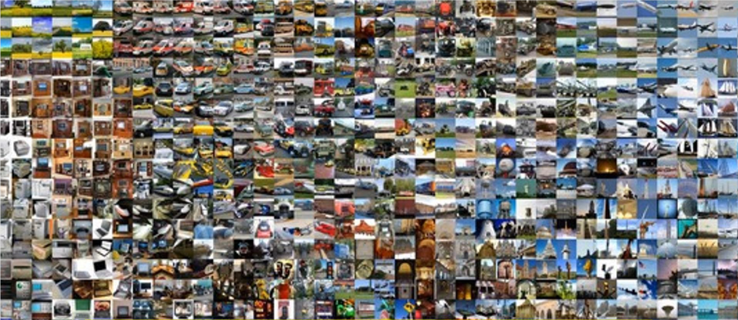
Training Data

Slide 5
Training, Validation and Testing datasets
We follow Kaggle rules (www.kaggle.com), these are:
Training Set: For training, they have labels and they are the ground truth
Validation Set: For validation of the model, they also have labels. Generally it is the 20%-30% of the Total set. It is used to avoid overfitting via the validation loss!
Testing set: It does not have labels and it is the way to see how the model generalizes. This is used in inference time to obtain the final value of the chosen metric of the model, i.e. Accuracy, F1_Score, mIOU, etc

Slide 6
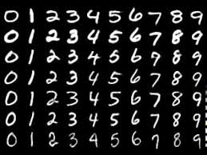
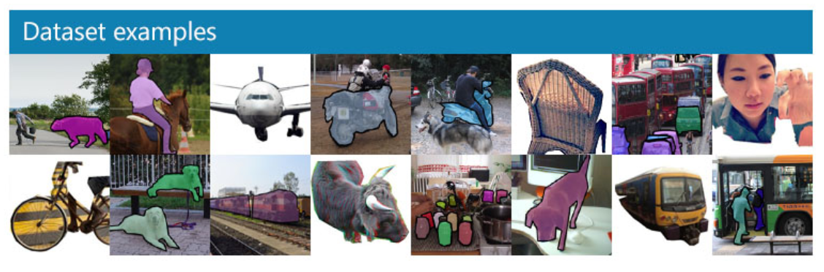
Famous Datasets
Mnist: handwritten numbers (http://yann.lecun.com/exdb/mnist/) Yann LeCun, et all
50,000, 28×28-pixel grayscale handwritten digits
Cifar10
60,000, 32×32-pixel color images in 10 classes
Coco: common objects in context for detection & segmentation (https://cocodataset.org/#home)
Planet: Multiclassification satellite from amazon rainforest (https://www.kaggle.com/nikitarom/planets-dataset)
Camvid: Segmentation Street datasets (http://mi.eng.cam.ac.uk/research/projects/VideoRec/CamVid/)
ImageNet: 1.3 million images of various sizes around 500 pixels across, in 1,000 categories, Standford University
There are many more !
Which ones?

Slide 7
Ways to collect data
- Primary: From the field, experiments, sensors, industry
- Secondary: From the Internet, papers, others

Slide 8
Different ways of annotate
In the folder’s name: motorcycles, cars, traffic_light.
- In the file name: it’s the most common: ex. dog1.jpg, horse3.jpg, cat2.jpg
- In a separate file: tipically in a .csv file
In a field of a table: target
In the whole image itself: segmentation

Slide 9
Search and scroll Google Images, Microsoft images using an api key
Be specific, less manual pruning you will have to do.
The maximum number of images Google Images shows is 700.
Put things you want to exclude into the search query using (-)
Limit your results to show only photos by clicking on Tools and selecting Photos from the Type dropdown.
ctrl+shift+j

Slide 10
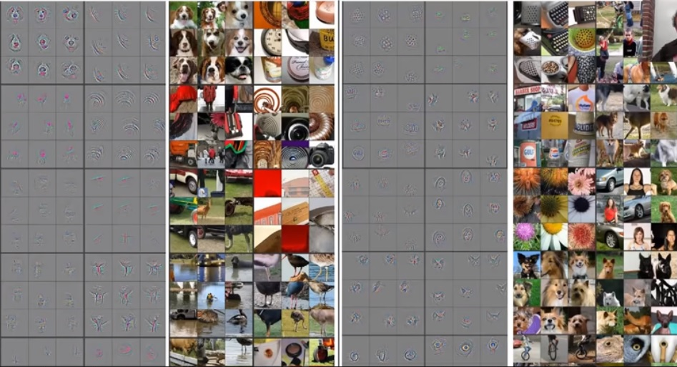
Transfer Learning
learn = create_cnn(data, models.resnet34, metrics=error_rate)

Slide 11
What is enough data?
If hyper parameters: architecture, epochs and learning rate are ok but model accuracy is still not good, below 60%
You need more data !!!!
How to get more data?

Slide 12
Data Augmentation and sintetic data
Programming is the solution, there is little workaround
Python is more than ok: PIL, CV2, imageo, albumentations modules do the trick!
Typical transformations are: rotate=flip, scale (affine), warping, Brightness, Intensity, Contrast (%s)
This can multiply actual data by 4 !
-Crappify and blurring is easy.
i.e. Albumentations

Slide 13
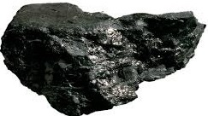
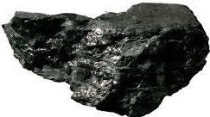
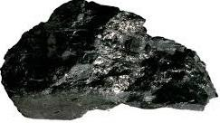
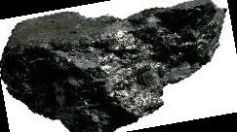
Data Augmentation = Image Transformations (Geometric, Color, etc)
Original
Rotated
Flip
Warped
i = Image.open(os.path.join(mypath, f))
print(f, i.size, i.mode)
i10 = i.rotate(10)
i10.save(os.path.join(mypath,'rot10{}.jpg'.format(fname)))
iflip = i.transpose(Image.FLIP_LEFT_RIGHT)
iflip.save(os.path.join(mypath,'flip{}.jpg'.format(fname)))
ifvert = i.transpose(Image.FLIP_TOP_BOTTOM)
ifvert.save(os.path.join(mypath,'fvert{}.jpg'.format(fname)))
iwarp = i.transform((new_width, height), (Image.AFFINE),(1, m, -xshift if m > 0 else 0, 0, 1, 0),
(Image.BICUBIC))

Slide 14
Examples of problems that can be solved
Binary classification: Damaged/No Damaged--------Prob 1/0 (CNN), Simple Label
Multi classification: Rock classification, Minerals, vipers, trees, outcrops, house assessment--------Prob Treshold above 0.6 (CNN), Multi Label
Image detection: Bounding boxes with probability
Segmentation: each pixel is assigned a value into a category (CNN encoding-decoding), Masks (1 color per class)
Image Generation: Cuttoff, marks & stinks, colorization, improve resolution (more advanced), Neural Style Transfer: GANs

Slide 15
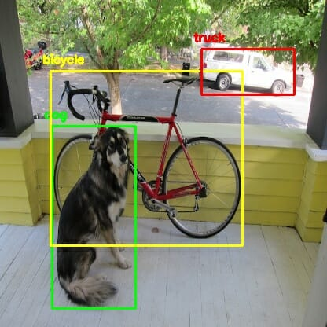
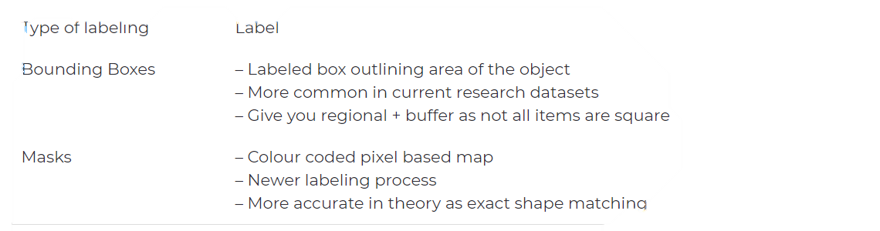

Different problems different types of datasets
Other:
In the file name
In the folder
In a separate cvs file

Slide 16
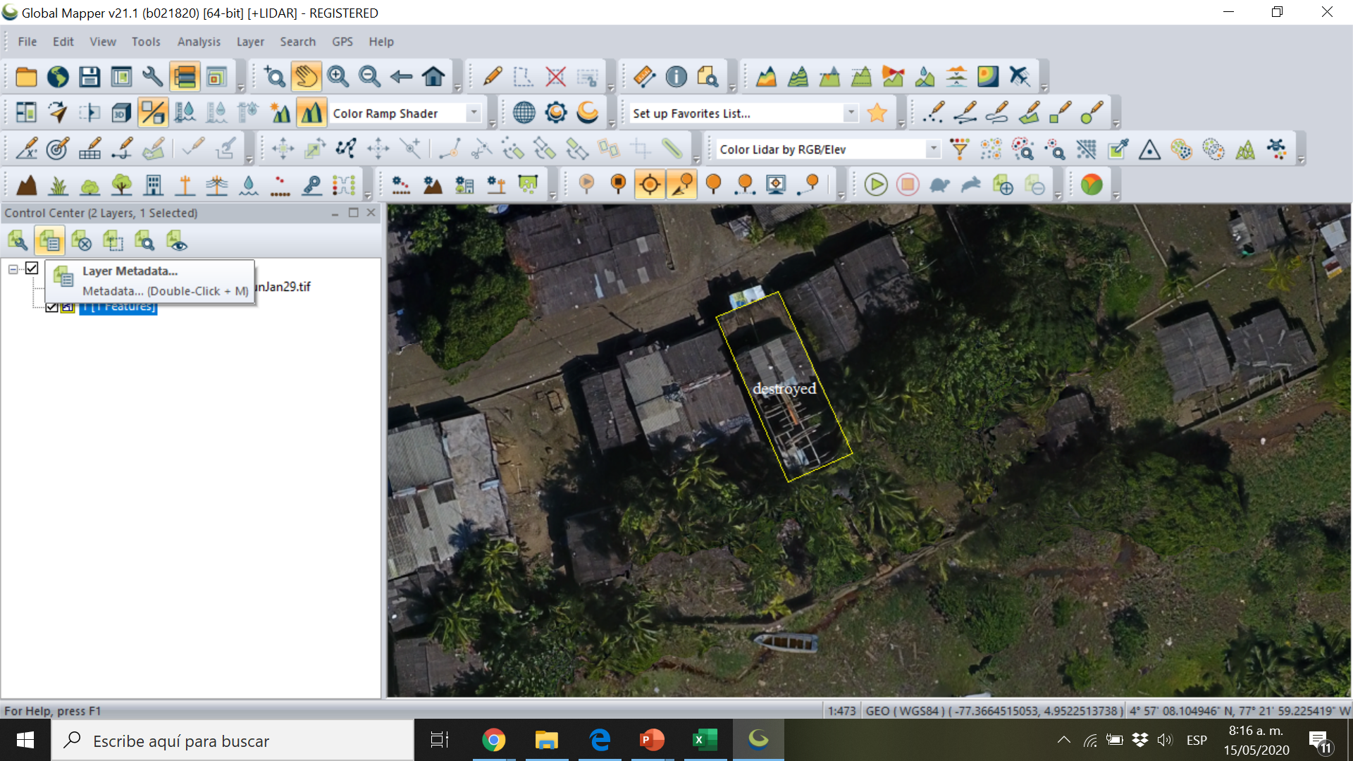
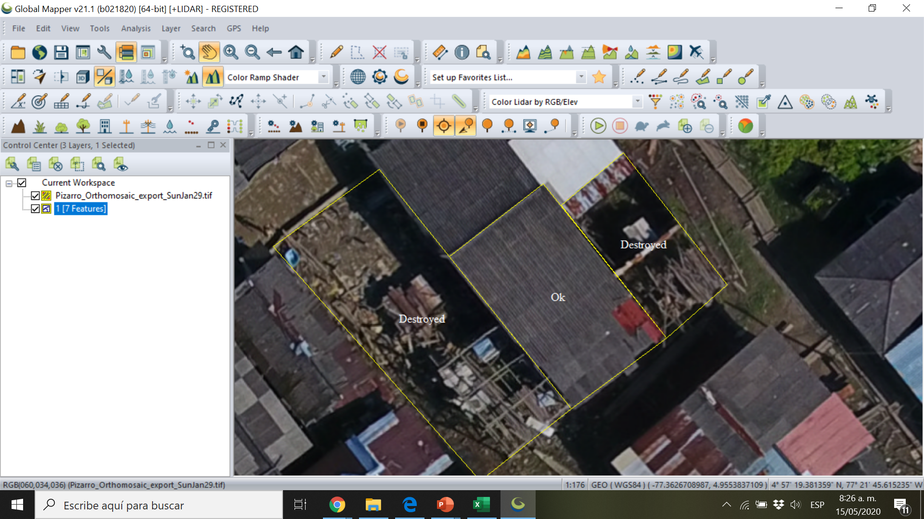
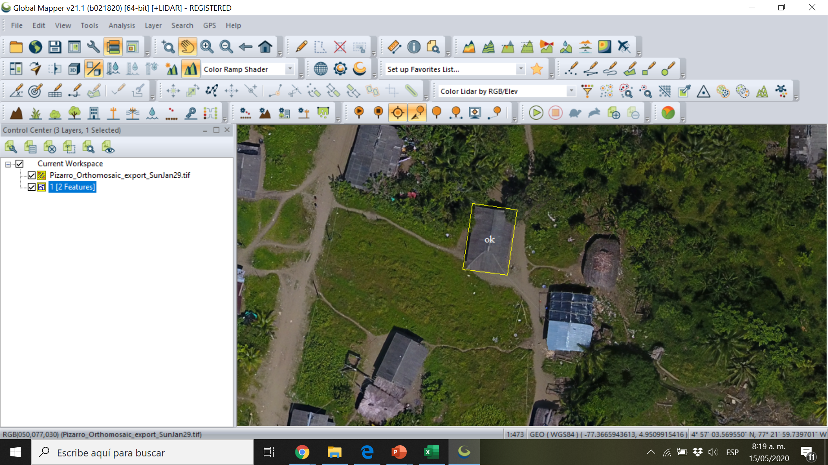
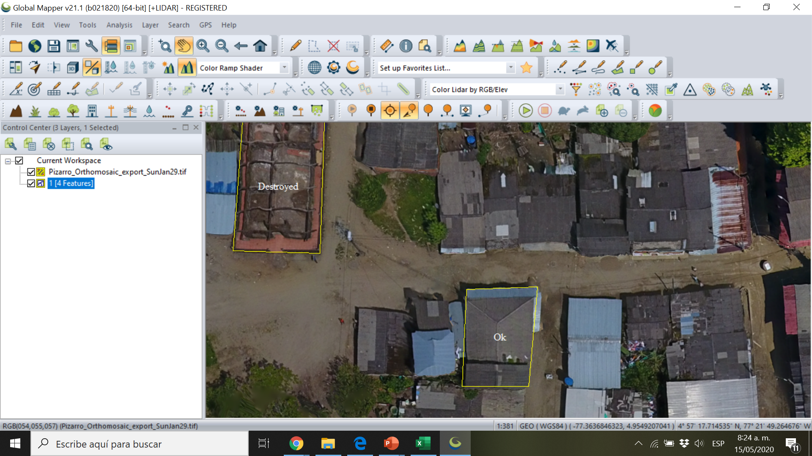

Slide 17
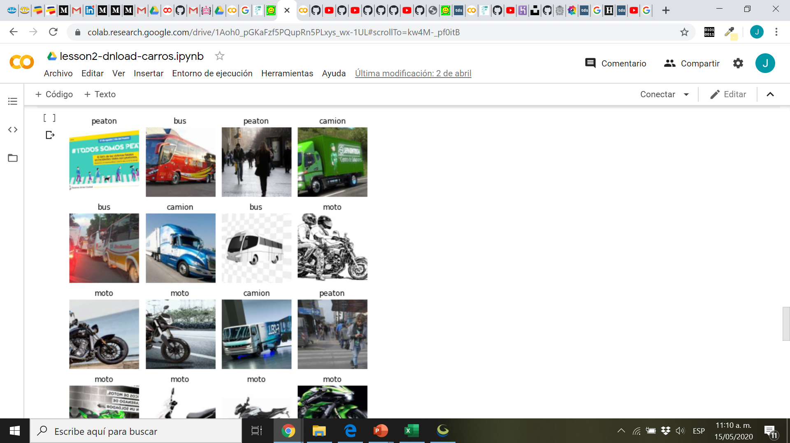
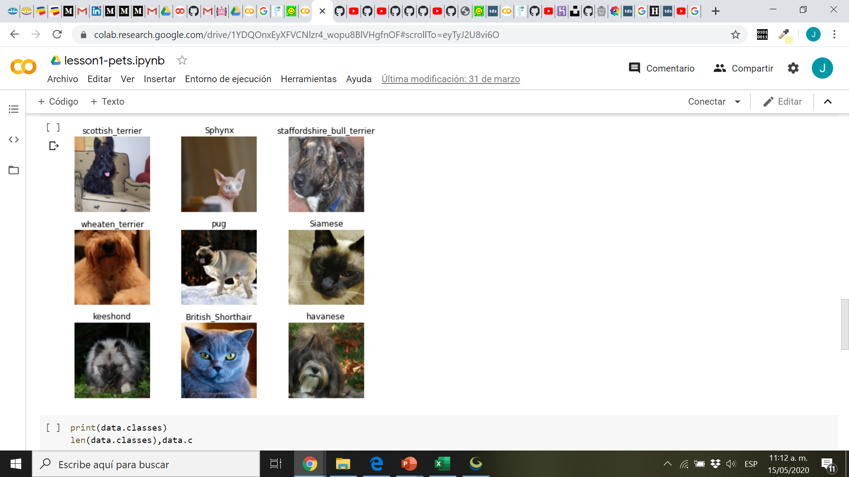
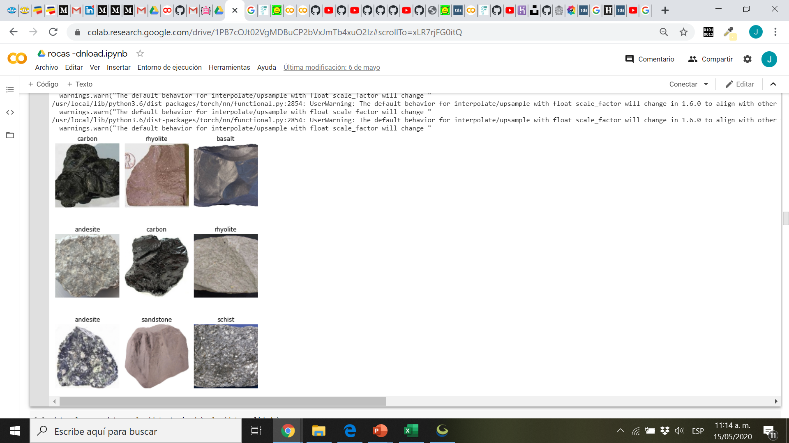

Slide 18
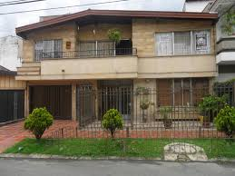
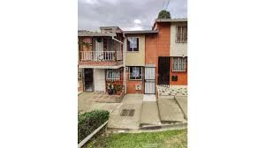
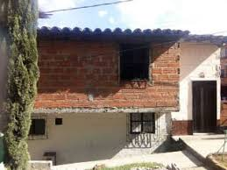
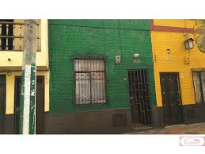
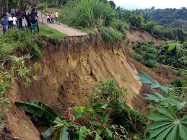
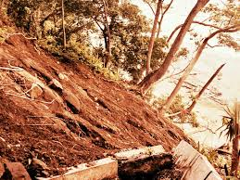
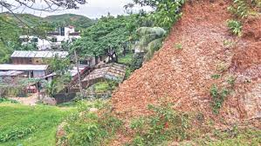
con acabados, garaje, ante jardín, varios pisos, grande, alto valor
con acabados, no garaje, no ante jardín, varios pisos, pequeña, medio valor
sin acabados, no garaje, no ante jardín, varios pisos, mediana, bajo valor
con acabados, no garaje, no ante jardín, 1 piso, pequeña, bajo valor
alta pendiente, no cobertura, alto peso, muy alto riesgo
alta pendiente, no cobertura, alto peso, muy alto riesgo
alta pendiente, no cobertura, bajo peso, muy bajo riesgo

Slide 19
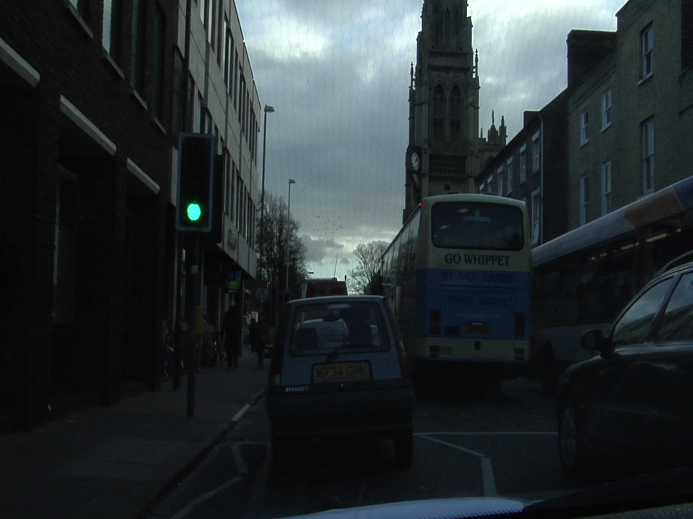

Camvid: Streets Segmentation Dataset

Slide 20
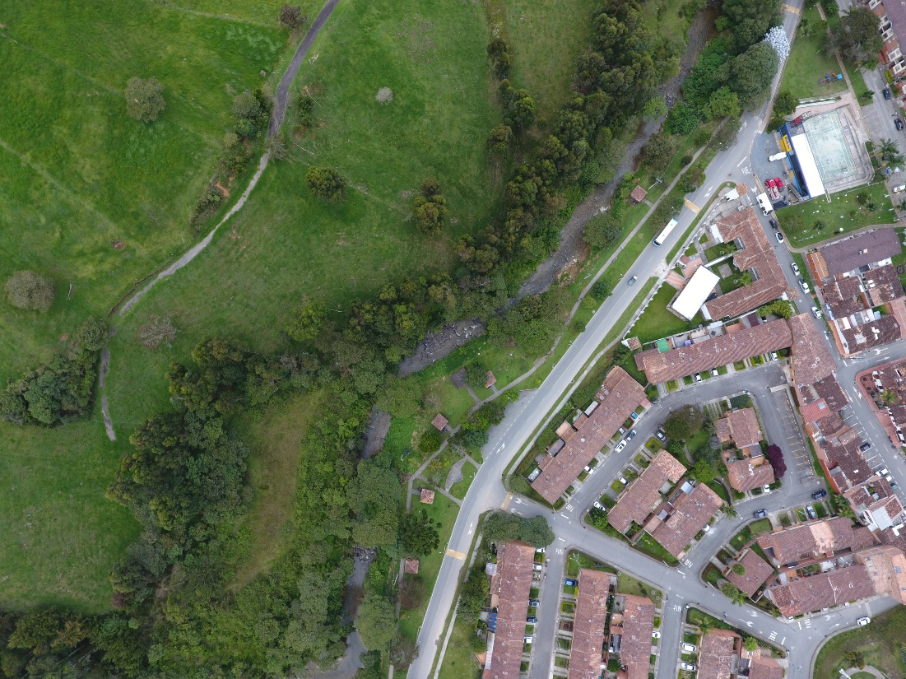
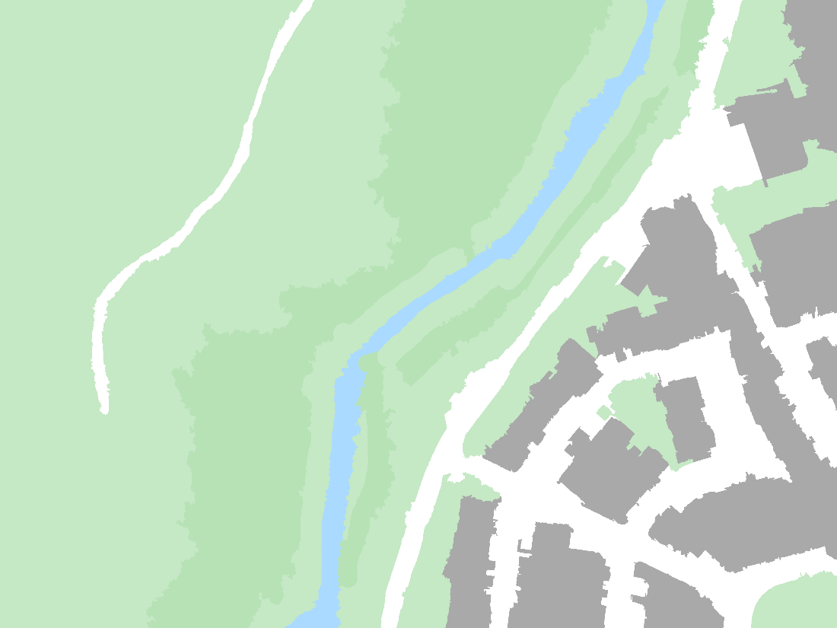
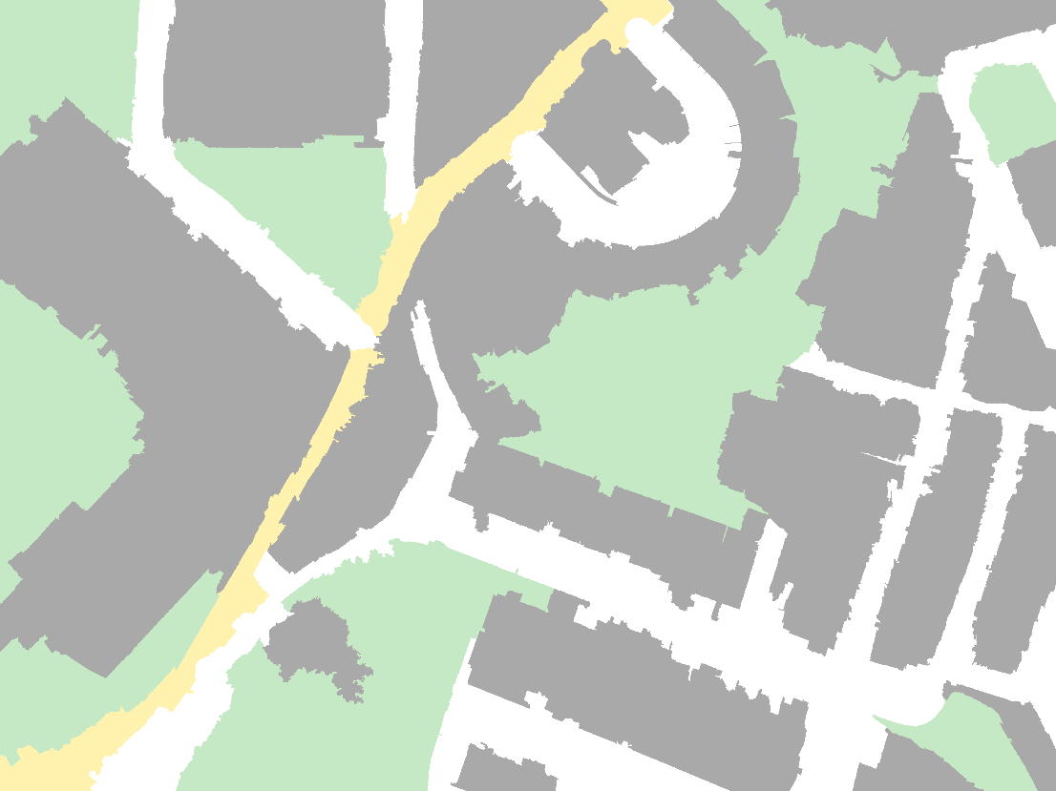
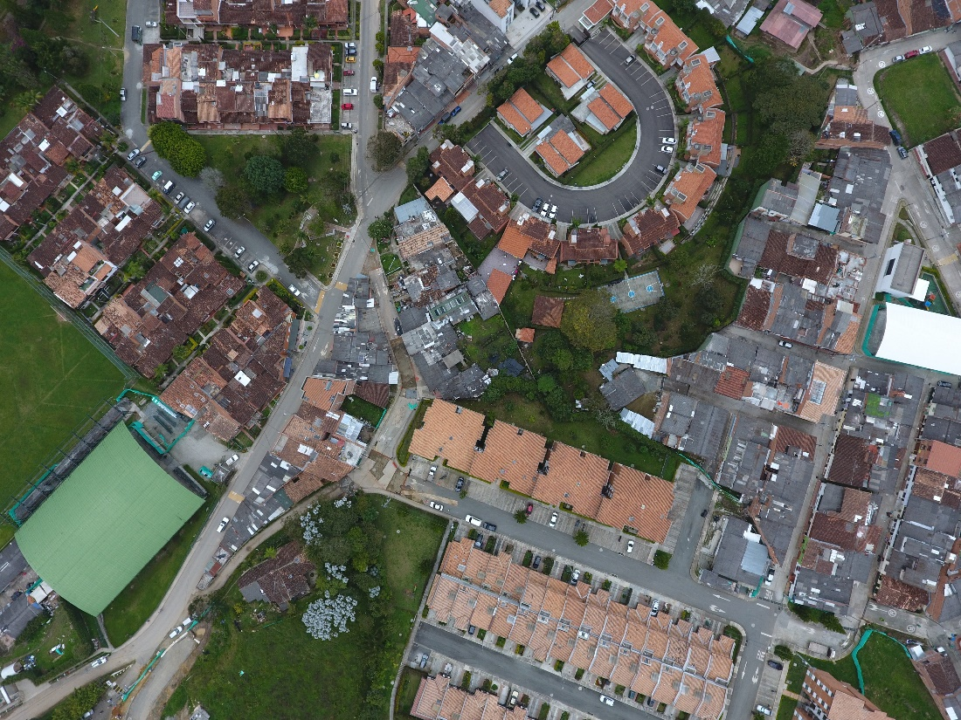
Landcover Segmentation Dataset

Slide 21
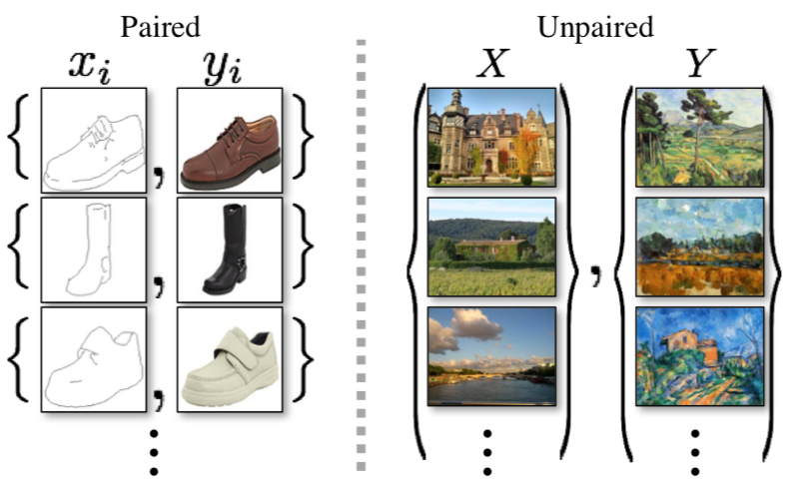
Types of training datasets for image generation
Unpaired Image-to-Image Translation using Cycle-Consistent Adversarial Networks Jun-Yan Zhu*, Taesung Park*, Phillip Isola, Alexei A. Efros Berkeley AI Research Lab, UC Berkeley In ICCV 2017. (* equal contributions)

Slide 22
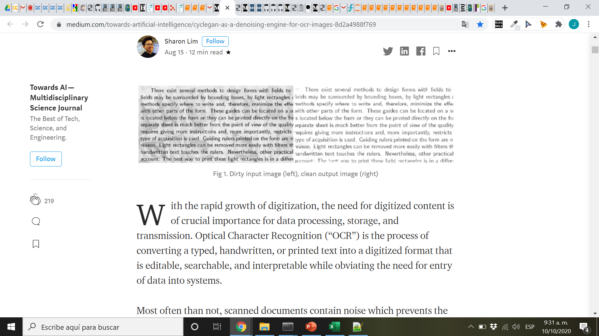
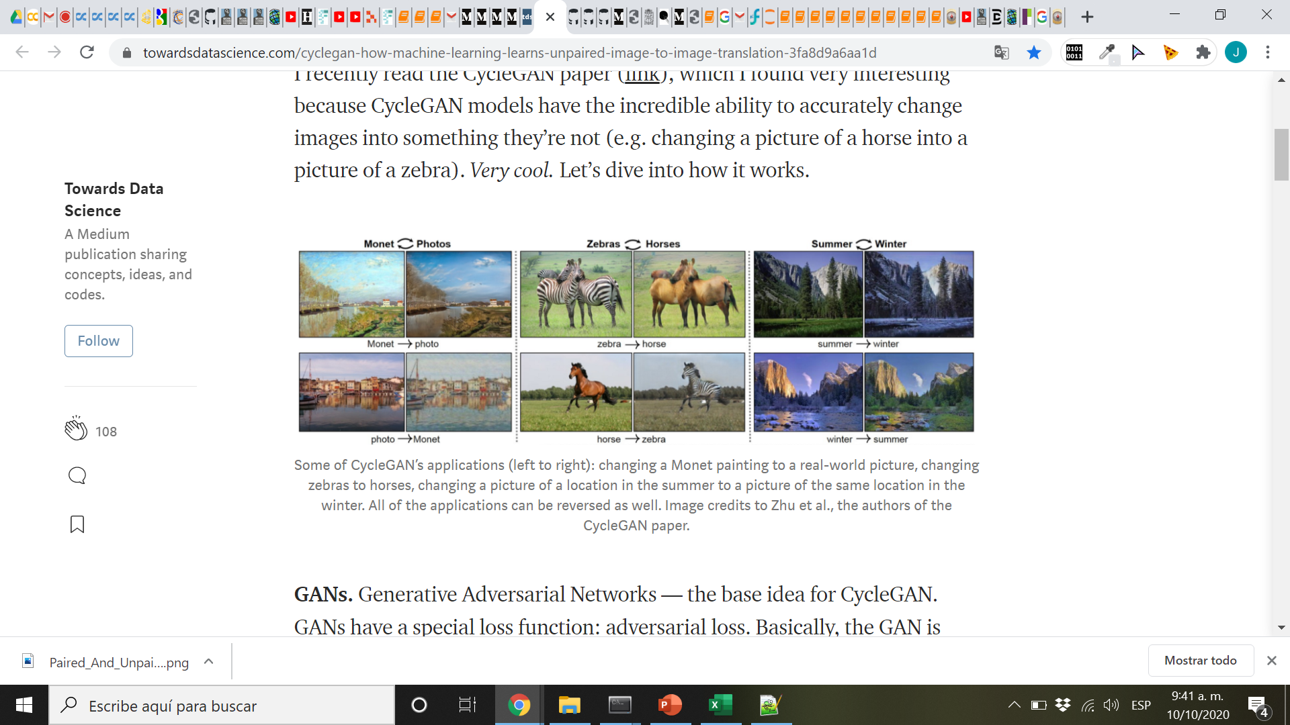
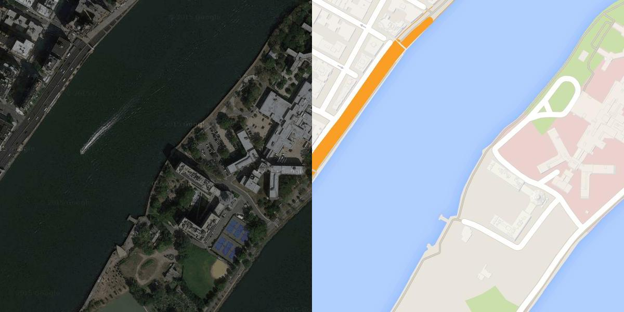
Image Translation: Cuttoff-marks & stinks, colorization, improve resolution, NST (neural style transfer)
Pix to pix
Supervised Learning !
Easy to learn and train, difficult to get data
Pix to pix image translation, Phillip Isola et al In ICCV 2017.

Slide 23
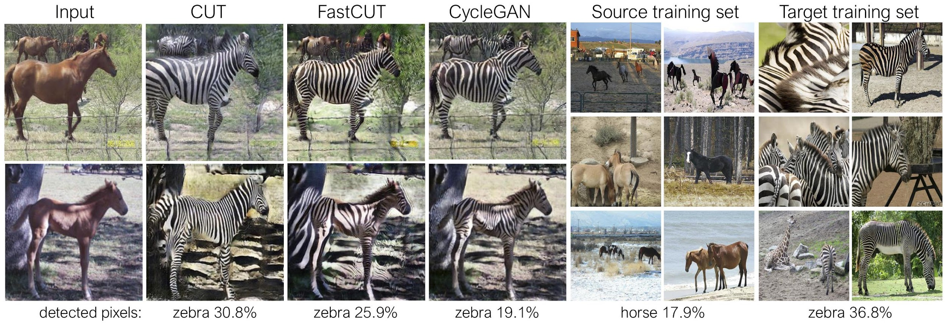
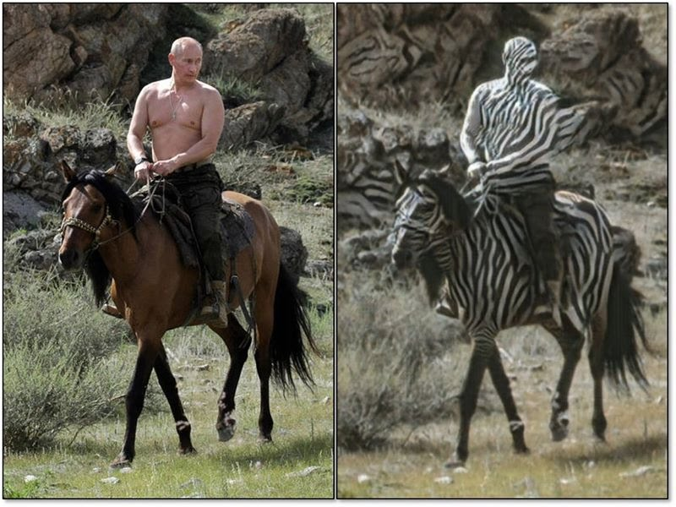
Object transfiguration
Unsupervised Learning !
Difficult to train and learn but easy to get training data
Unpaired Image-to-Image Translation using Cycle-Consistent Adversarial Networks Jun-Yan Zhu*, Taesung Park*, Phillip Isola, Alexei A. Efros Berkeley AI Research Lab, UC Berkeley In ICCV 2017. (* equal contributions)

Slide 24
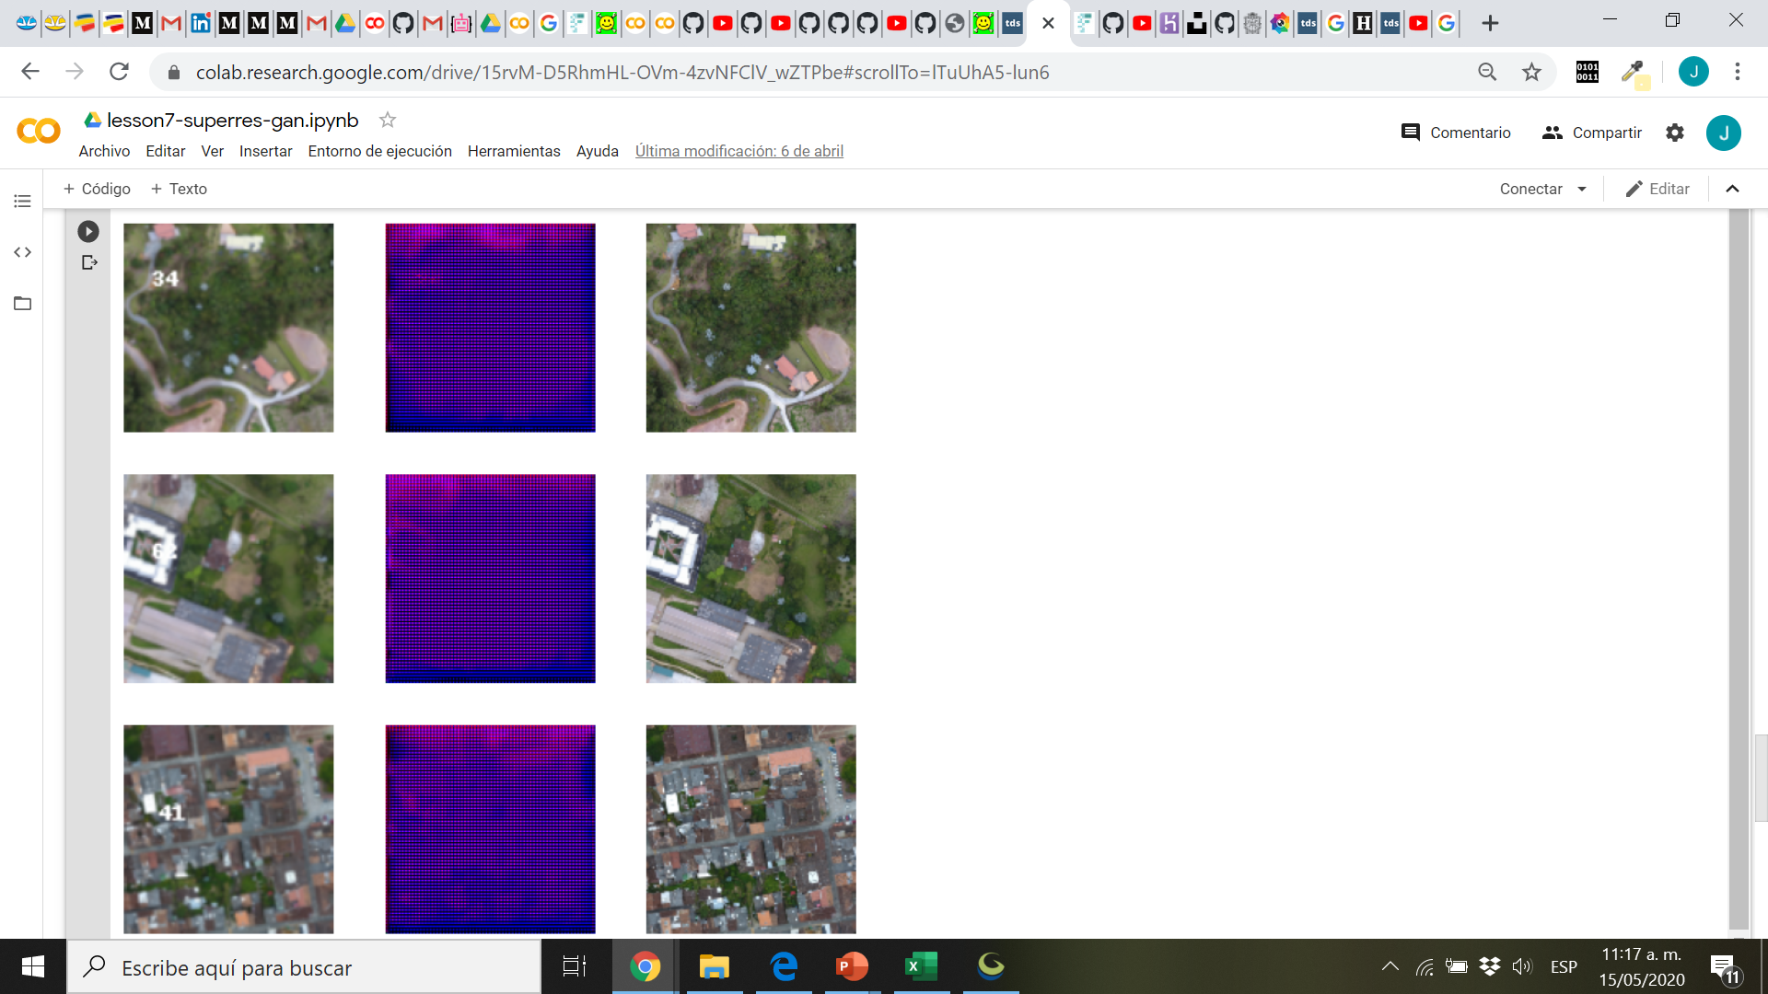

Slide 25
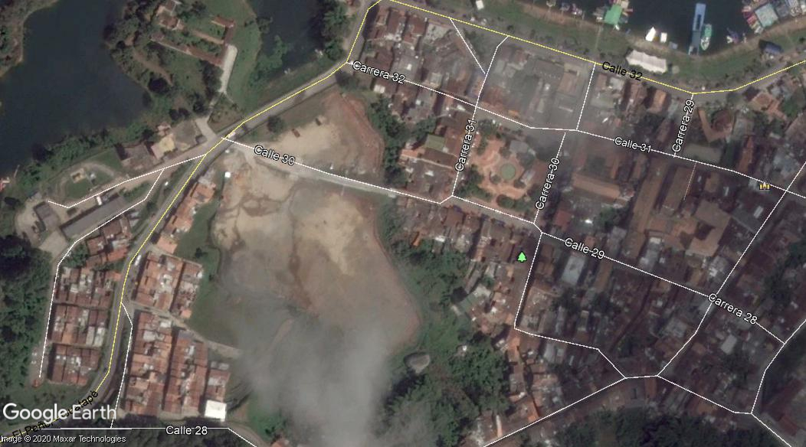
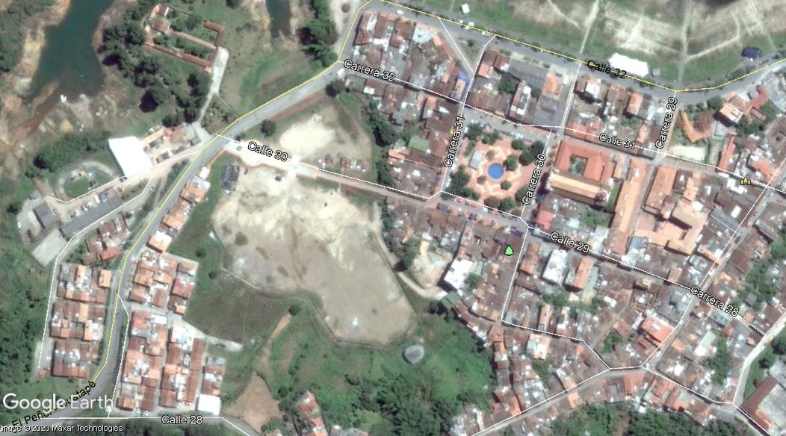
Labelling Time (research topic)

Slide 26
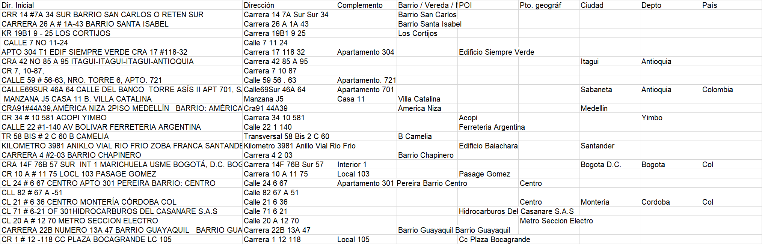
What about data in text and tables? NMT: Neural Machine Translation

Slide 27
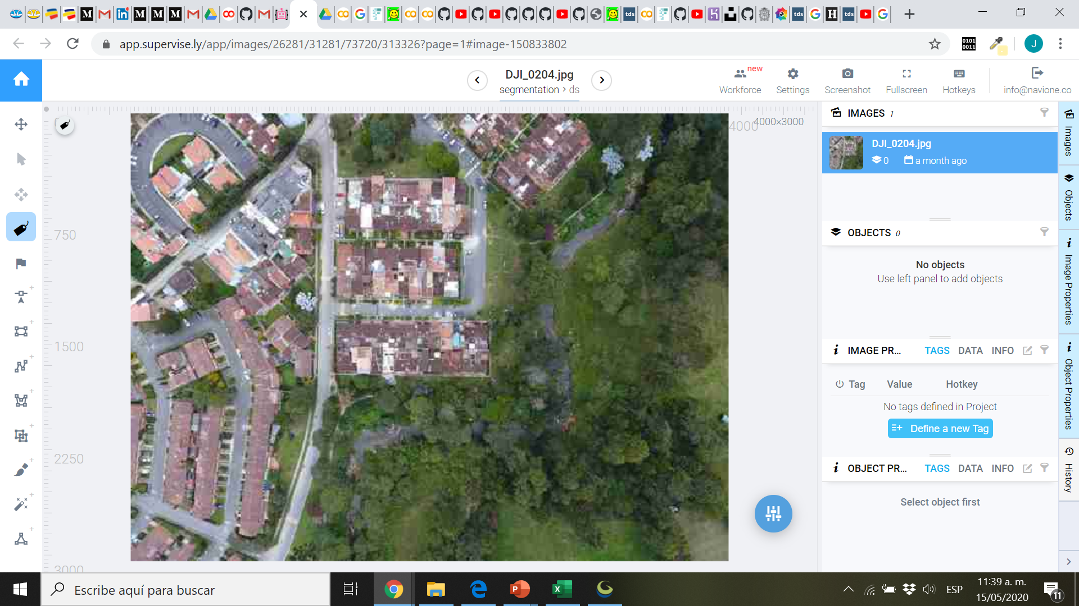
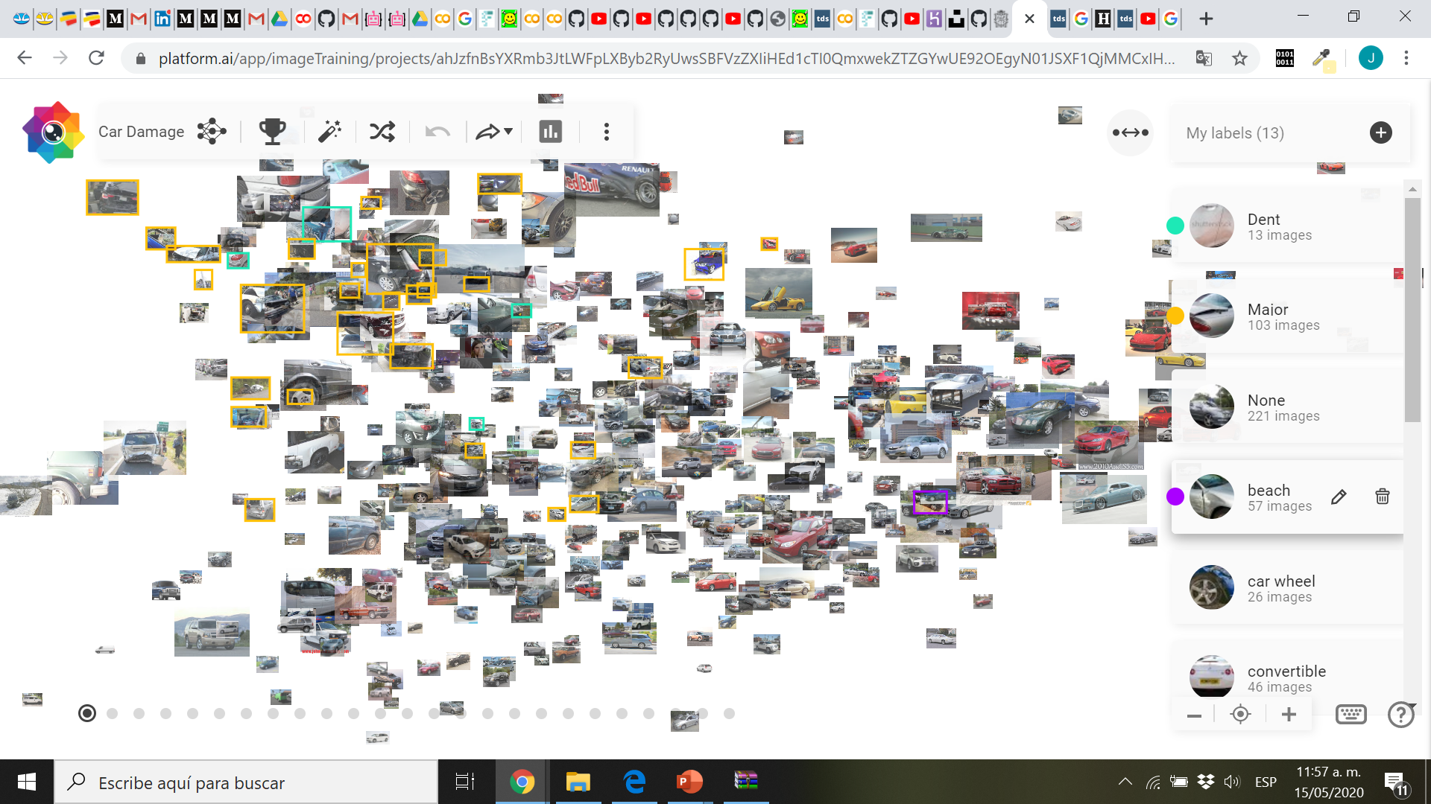
Software for Labelling
Supervisely: www.app.supervise.ly
Platform.ai: www.platform.ai
PixelAnnotationTool (github.com/abreheret/PixelAnnotationTool)

Slide 28
Working Examples
multilabel.herokuapp.com

